Slide 1
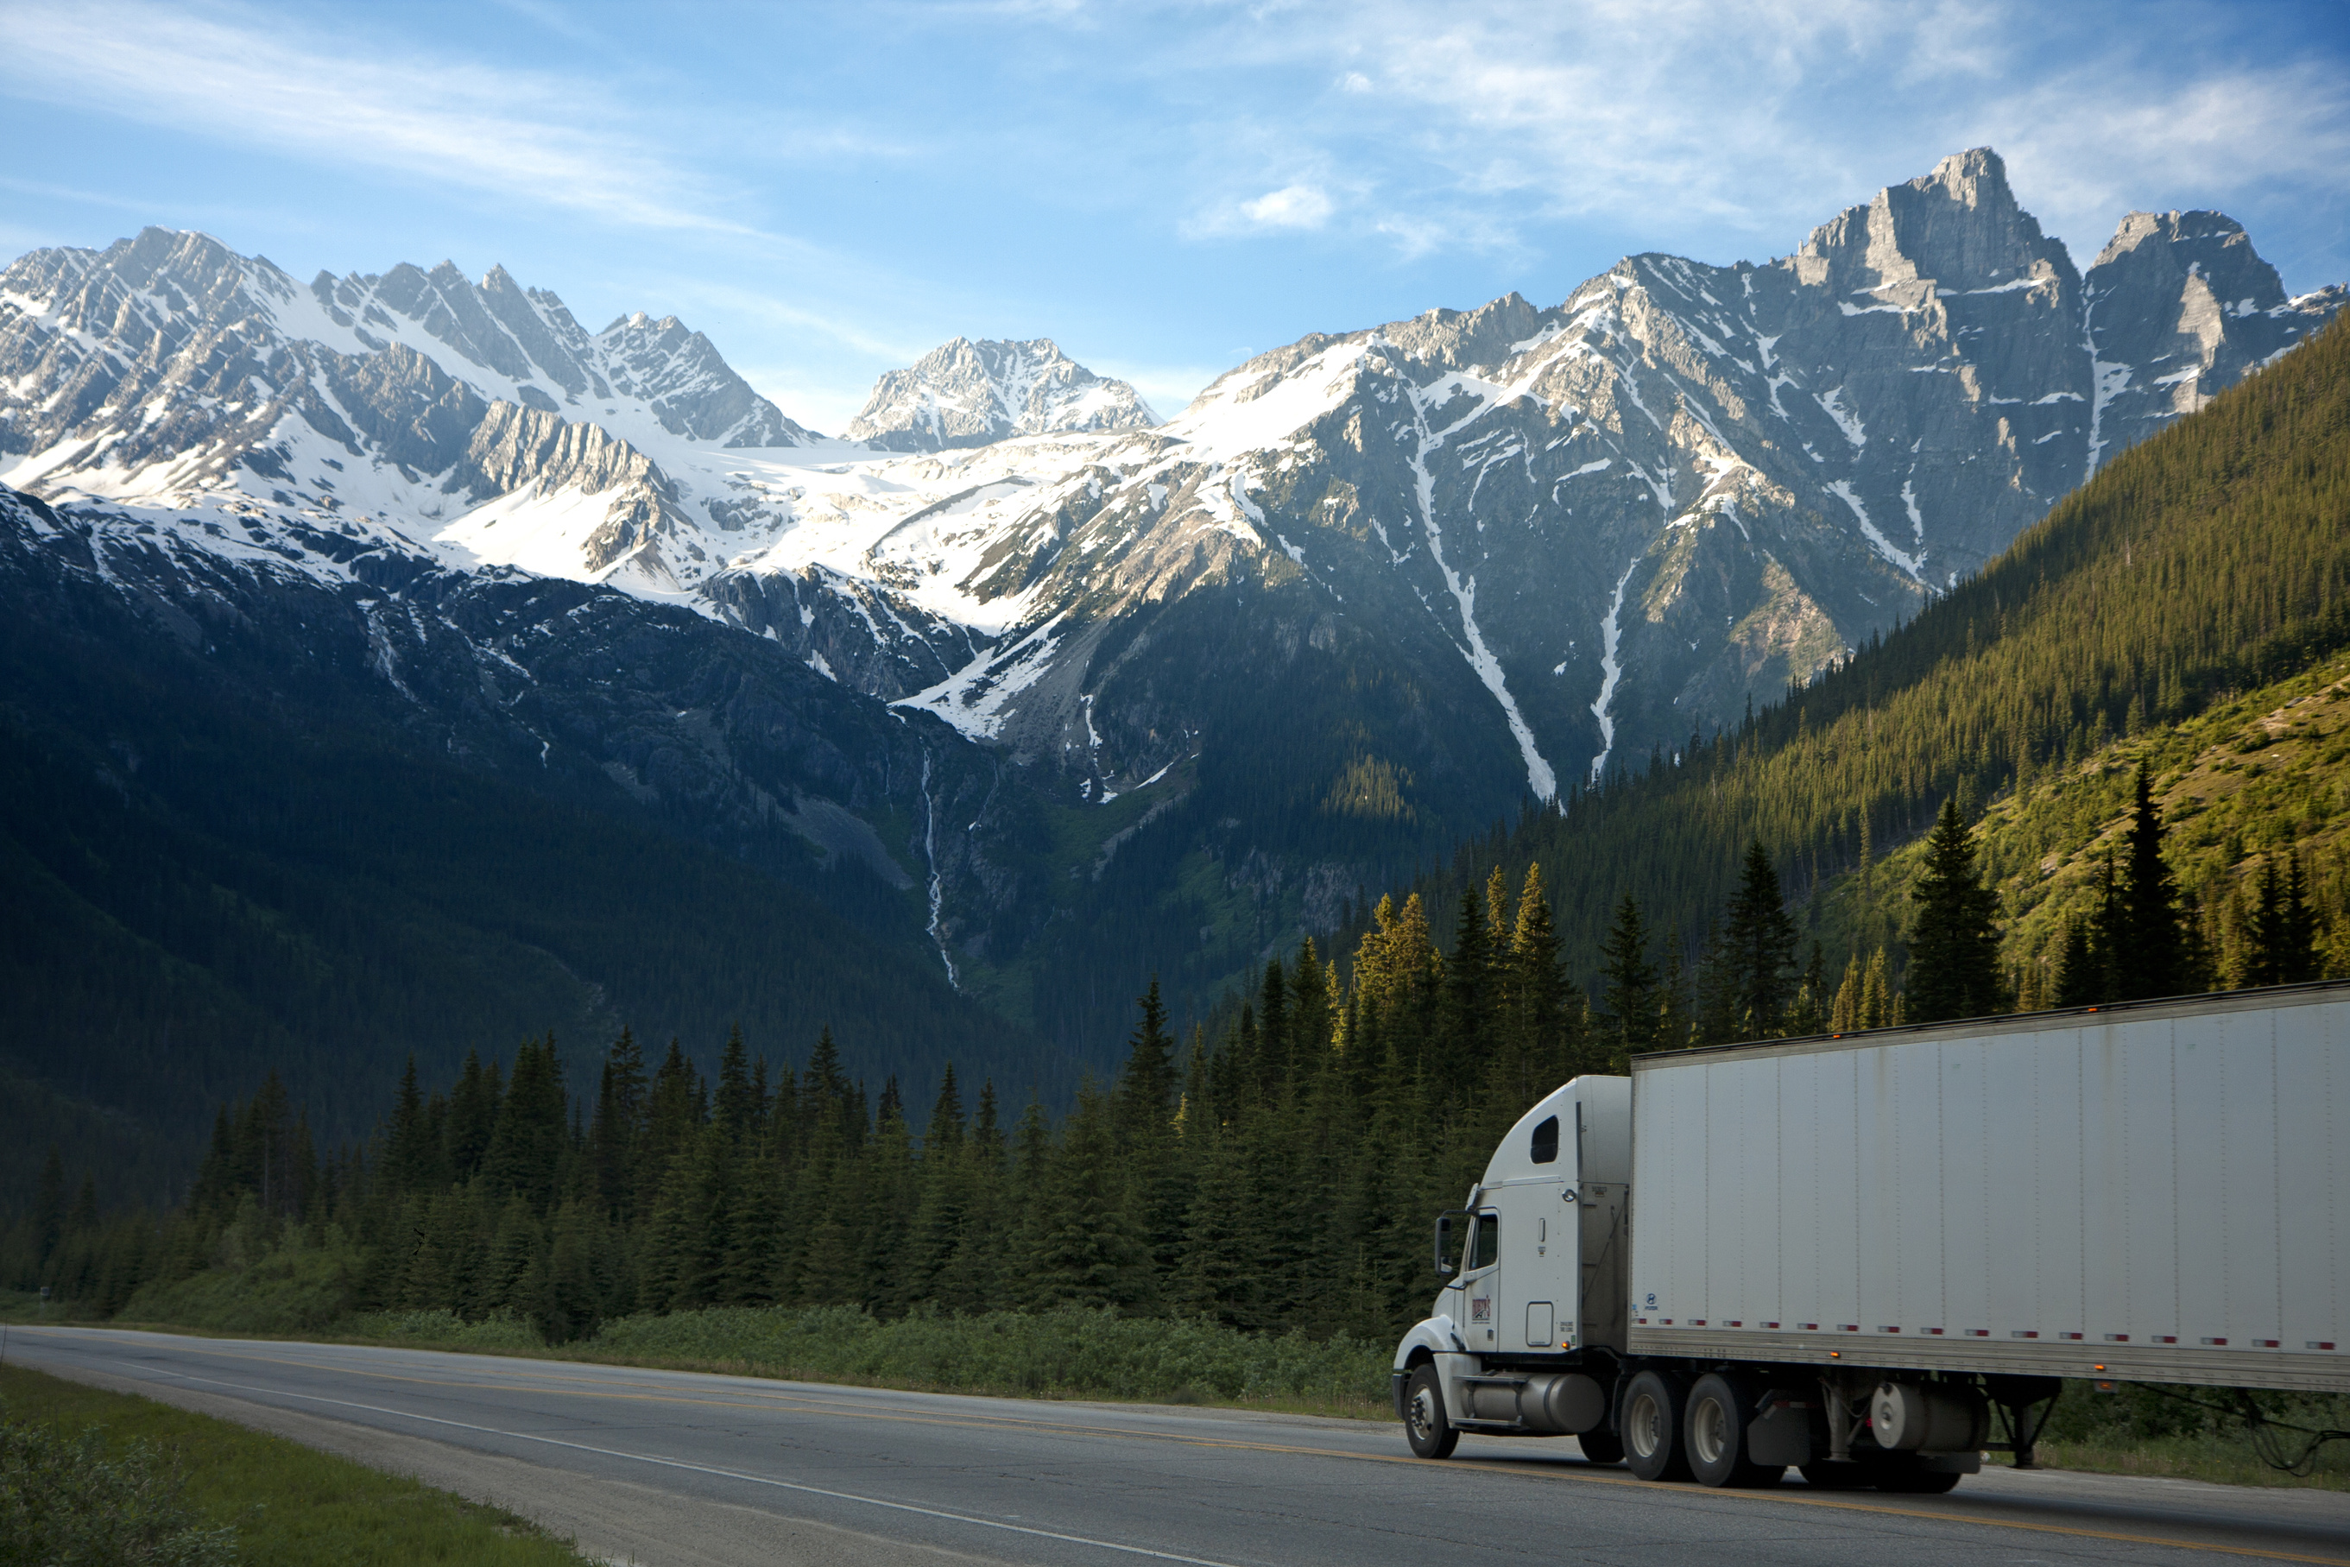

Data Modeling Project
Group : 3
Supply Chain Business Process
DataCo SMART SUPPLY CHAIN

Slide 2






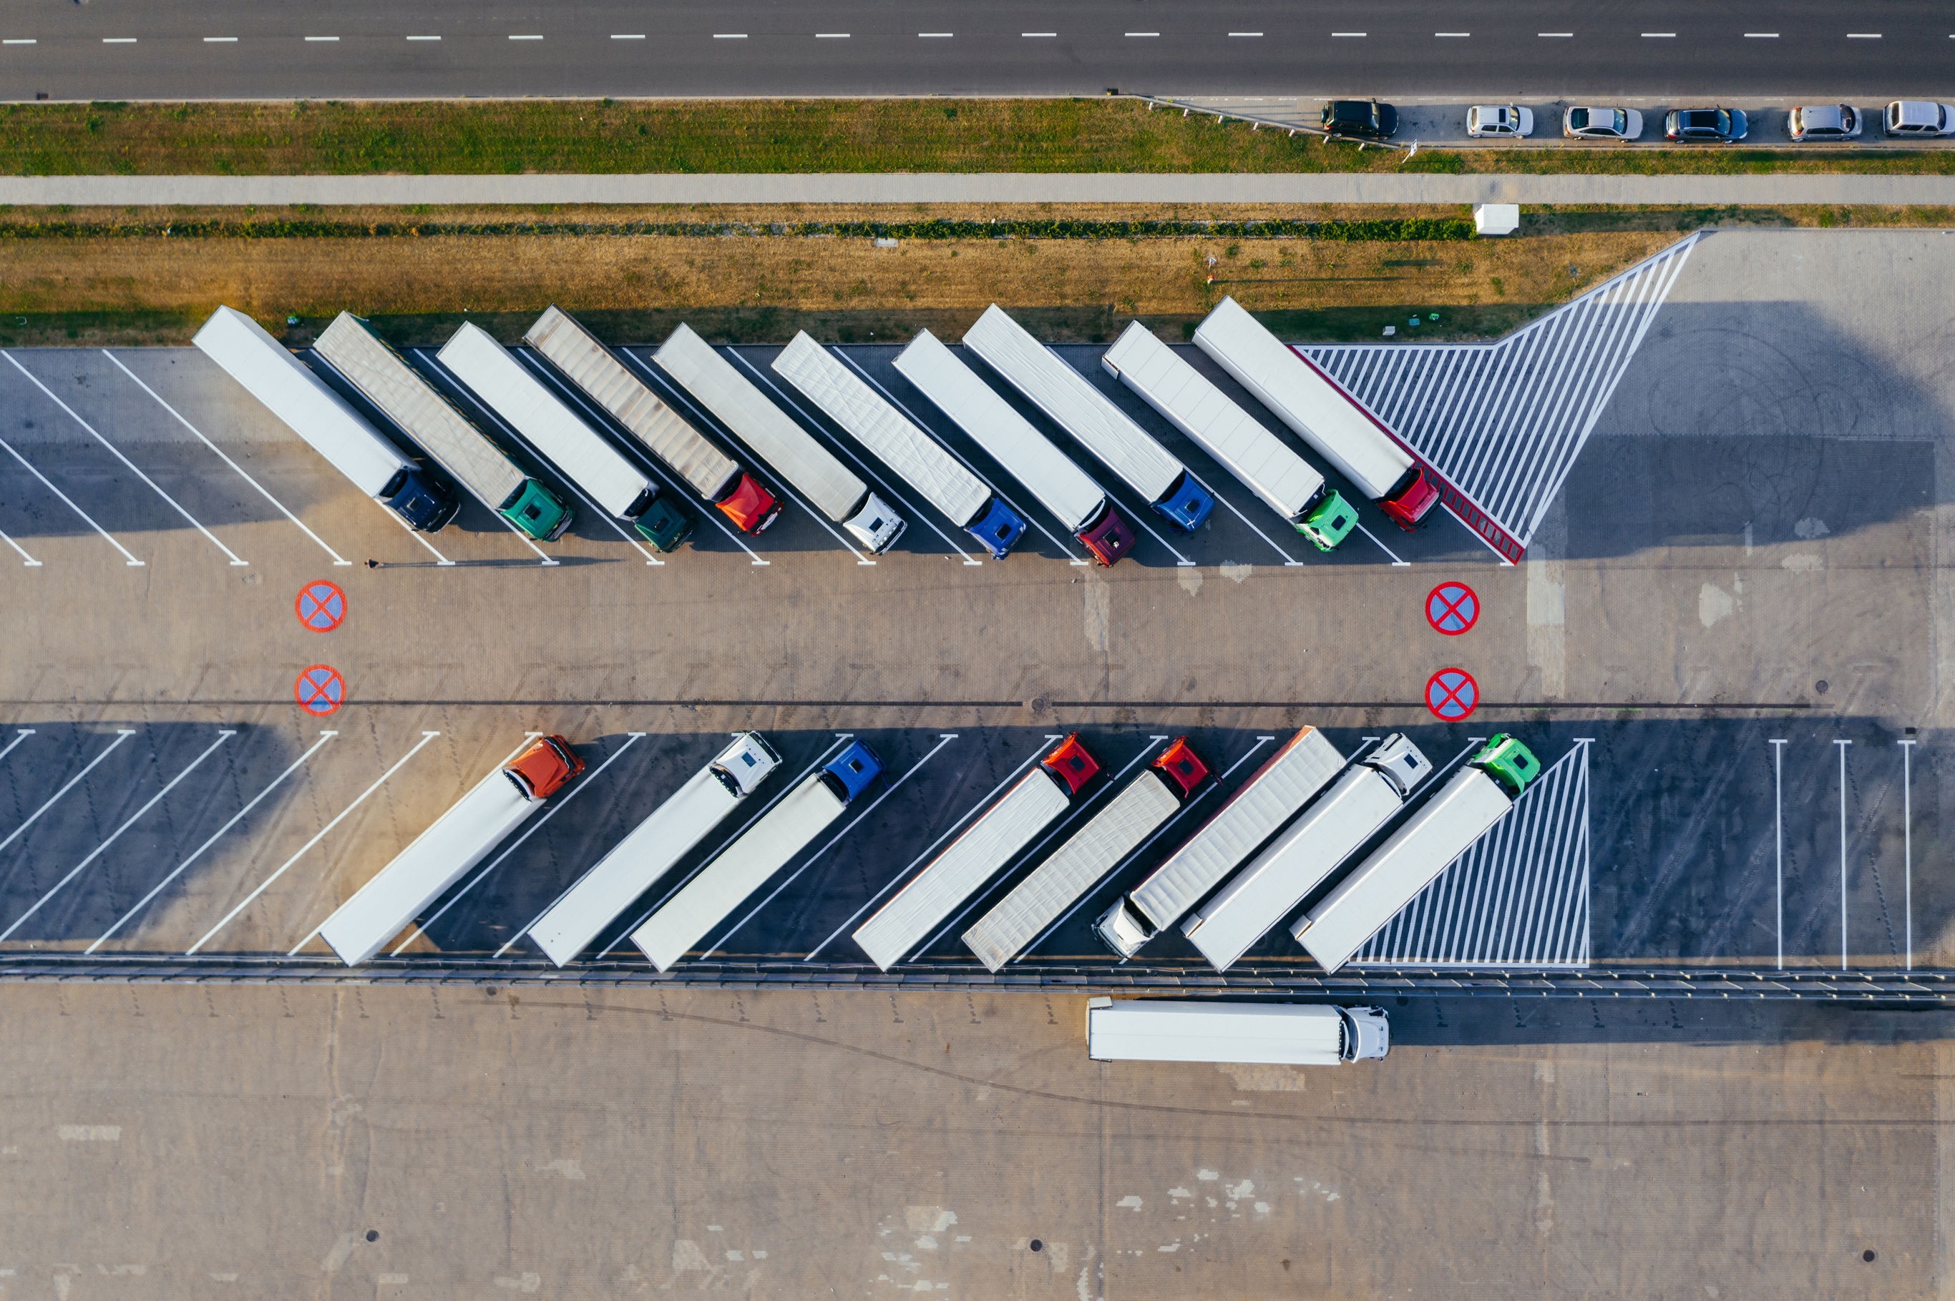
Team : G3
AdhirajkedarPustake
Md Irteza Chowdhury
Mohammed Abdul Haseeb
Tacco-Melendez John
Mohamed Abdelsalam

Slide 3


Data Source
kaggle.com
SEARCH
https://data.mendeley.com/datasets/8gx2fvg2k6/5
Name : DataCo SMART SUPPLY CHAIN FOR BIG DATA ANALYSIS

Slide 4
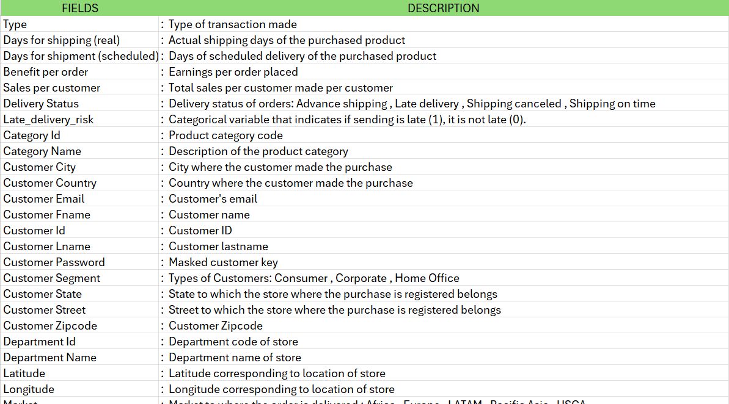
Data Description
Meta-Data
Column : 52
Rows : 180.5K

Slide 5

Five Business Process
Sales Process-Adhiraj
Capture all details related to sales and profit.
Payment Tracking-Abdul
Track payment states (PENDING, PROCESSING, PAYMENT_REVIEW, ON_HOLD, SUSPECTED_FRAUD, COMPLETE, CLOSED, CANCELED )
Shipment Tracking-Mohammed
Track shipment states (Processing, In Transit, Cancelled, Delivered )
Track product performance (Total Sales (before discount) Units Sold Amount Discounted Total Sales (After Discount) Total Profit Order Count)
Product Performance-John
Track daily inventory levels in departments
Inventory Management-Irteza

Slide 6
Type of Fact Table
Sales Process
Transaction Fact
Payment Tracking
Accumulating Fact
Shipment Tracking
Accumulating Fact
Periodic Fact ( Monthly)
Product Performance
Periodic Fact (Daily)
Inventory Management

Slide 7
Conceptual Logical Model: Fact Transaction Fact table
 | Conceptual | Logical
Fact | Sales Process | Order Id
 |  | Order Date
 |  | Quantity (items)
 |  | Sales (After discount)
 |  | Discount Amount
 |  | Total Profit
 |  | Order Status ID
 |  | Customer Id
 |  | Transaction Type ID
 |  | Customer Segment ID
 |  | Sales (before Discount)
 |  | Department ID
 |  | Customer Location ID
 |  | Department Location ID
Sales Process

Slide 8
Conceptual Logical Model: Dimension
Dimension | Conceptual | Logical
 | Customer | Customer ID
 |  | Customer Fname
 |  | Customer Lname
 | Customer Segment | CustomerSegmentID
 |  | Customer Segment
 | Location | Location ID
 |  | City
 |  | Country
 |  | Latitude
 |  | Longitude
 |  | Market
 |  | Location Type
 |  | State
 |  | Street
 |  | Zip code
 | Transaction Type | Transaction Type ID
 |  | Transaction Type
 | Department | Department ID
 |  | Department Name
 | Date | Date
 | Order Status | Order Status ID
 |  | Order Status
Sales Process

Slide 9
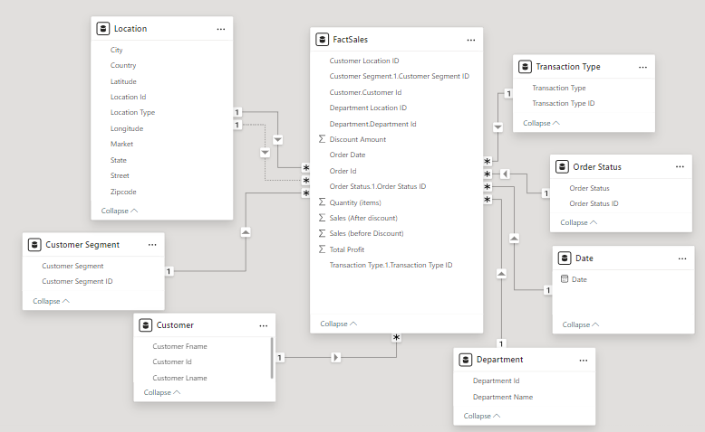

Slide 10
Conceptual Logical Model: Fact Accumulating Fact table
 | Conceptual | Logical
Fact | Payment Tracking | Order Id
 |  | Customer Id
 |  | Customer Segment ID
 |  | Date
 |  | Transaction Type ID
 |  | Department Id
 |  | Customer Location ID
 |  | Order Status ID
 |  | Tracking State ID
 |  | Department Location ID
 |  | Cancelled Payment Count
 |  | Complete Payment Count
 |  | On Hold Payment Count
 |  | Payment Review Count
 |  | Pending Payment Count
 |  | Processing Payment Count
 |  | Suspected Fraud Count
Payment Tracking

Slide 11
Conceptual Logical Model: Dimension
Dimension | Conceptual | Logical
 | Customer | Customer ID
 |  | Customer First Name
 |  | Customer Last Name
 | Customer Segment | Customer Segment ID
 |  | Customer Segment
 | Transaction Type | Transaction Type ID
 |  | Transaction Type
 | Department | Department ID
 |  | Department Name
 | Location | Location ID
 |  | City
 |  | Country
 |  | Lat
 |  | Long
 |  | Market
 |  | Location Type
 |  | Street
 |  | Zip code
 |  | State
 | Order Status | Order Status ID
 |  | Order Status
 | Date | Date
Payment Tracking

Slide 12
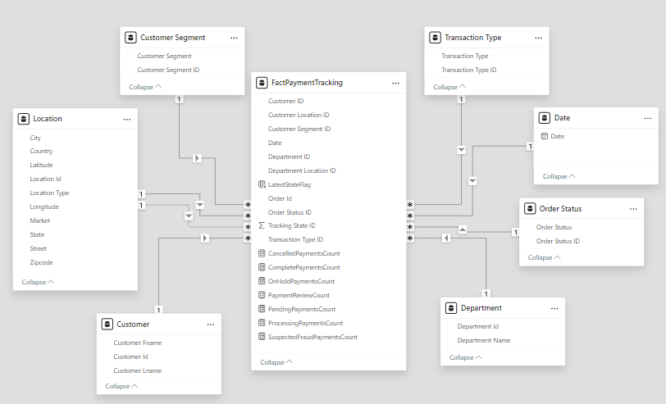

Slide 13
Conceptual Logical Model: Fact Accumulating Fact
 | Conceptual | Logical
Fact | Shipment Tracking | Order Id
 |  | Date
 |  | Delivery Location ID
 |  | Delivery Status ID
 |  | Inventory Location ID
 |  | Tracking State ID
 |  | Customer ID
 |  | Shipping Mode ID
 |  | Customer segment ID
 |  | Department ID
 |  | Count Cancelled
 |  | Count Delivered
 |  | Count In Transit
 |  | Count Processing
Shipment Tracking

Slide 14
Conceptual Logical Model: Dimension
Dimension | Conceptual | Logical
 | Customer | Customer
 |  | Customer ID
 |  | Customer First Name
 |  | Customer Last Name
 | Customer Segment | Customer Segment ID
 |  | Customer Segment
 | Shipping Mode | Shipping Mode ID
 |  | Shipping Mode
 | Location | Location ID
 |  | City
 |  | Country
 |  | Latitude
 |  | Longitude
 |  | Market
 |  | Location Type
 |  | State
 |  | Street
 |  | Zip Code
 | Department | Department ID
 |  | Department Name
 | Delivery Status | Delivery Status ID
 |  | Delivery Status
 | Date | Date
Shipment Tracking

Slide 15
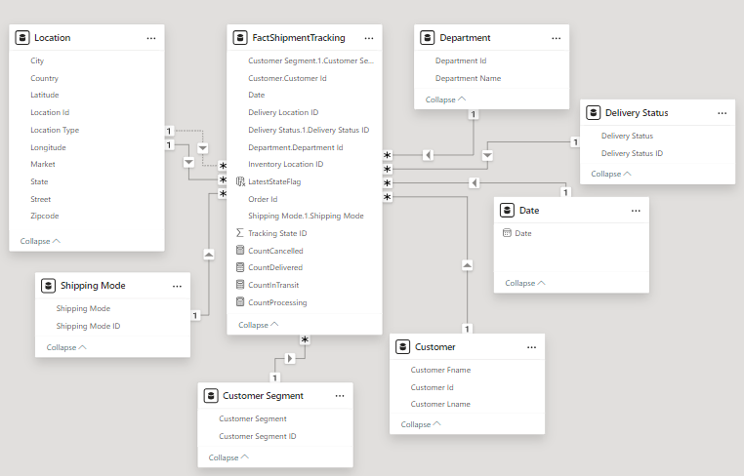

Slide 16
Conceptual Logical Model: Fact Monthly Periodic Snapshot
 | Conceptual | Logical
Fact | Product Performance | Product Performance ID
 |  | Units Sold
 |  | Amount Discounted
 |  | Total Sales (After Discount)
 |  | Total Sales (before discount)
 |  | Order Count
 |  | Product Id
 |  | Product Category Id
 |  | Department Id
 |  | Date
 |  | Total Profit
Product Performance Business Process

Slide 17
Conceptual Logical Model: Dimension
Dimension | Conceptual | Logical
 | Product | Product Name
 |  | Product Id
 |  | Product Image
 |  | Product Price
 | Product Category | Product Category Name
 |  | Product Category Id
 | Department | Department Id Department Name
 | Date | Date
Product Performance Business Process

Slide 18
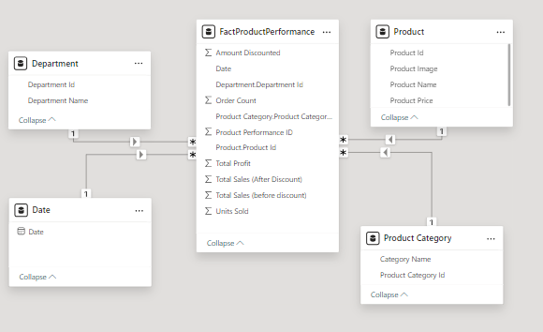

Slide 19
Conceptual Logical Model: Fact Daily Periodic Fact
 | Conceptual | Logical
Fact | Inventory Management | Date
 |  | Product Id
 |  | Department Id
 |  | Quantity
 |  | In Stock
 |  | New Stock Arrival
 |  | Inventory Location ID
 |  | Product Category ID
 |  | Department ID
 |  | Inventory ID
 |  | Replenish Amount
 |  | Supplier Location ID
Inventory Management Business Process

Slide 20
Conceptual Logical Model: Dimension
Dimension | Conceptual | Logical
 | Location | City
 |  | Country
 |  | Latitude
 |  | Location ID
 |  | Location Type
 |  | Longitude
 |  | Market
 |  | State
 |  | Street
 |  | Zip Code
 | Product | Product Name
 |  | Product Id
 |  | Product image
 |  | Product Price
 | Product Category | Category Name
 |  | Product Category Id
 | Department | Department ID
 |  | Department Name
 | Supplier | Supplier ID
 |  | Supplier Name
 |  | Contact Name
 |  | Phone Number
 |  | Contact Email
 | Date | Date
Inventory Management Business Process

Slide 21
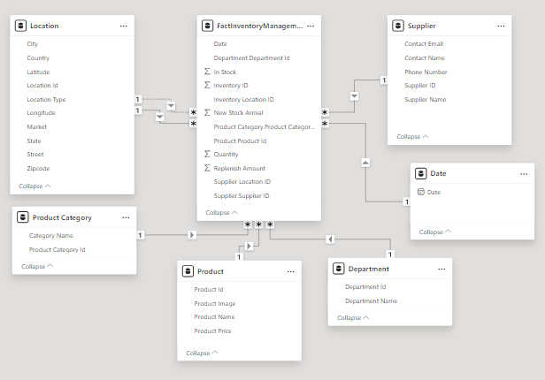

Slide 22
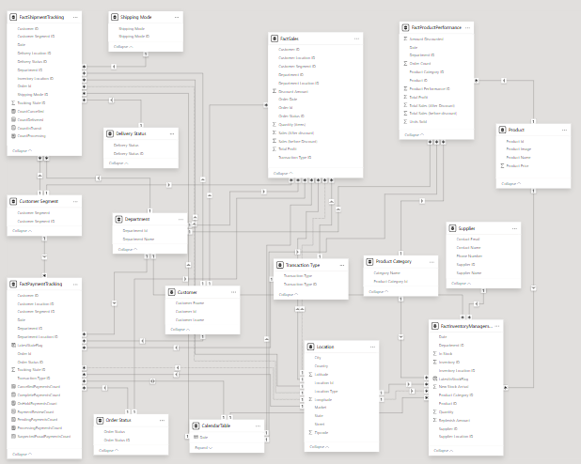


Slide 23
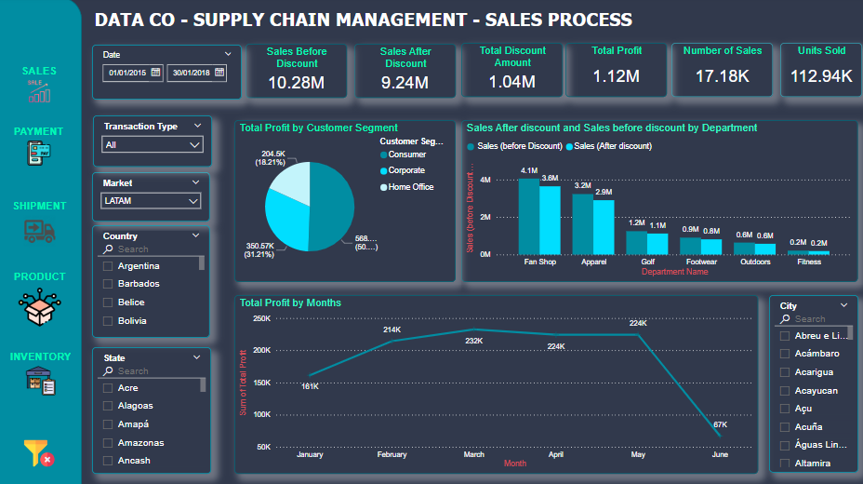

Slide 24
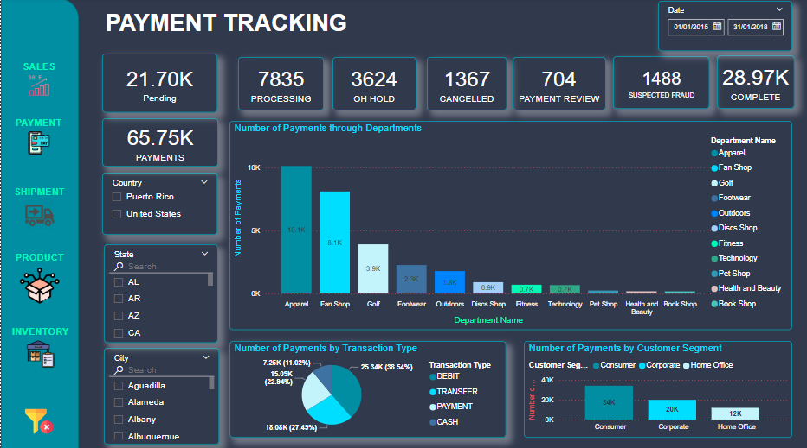

Slide 25
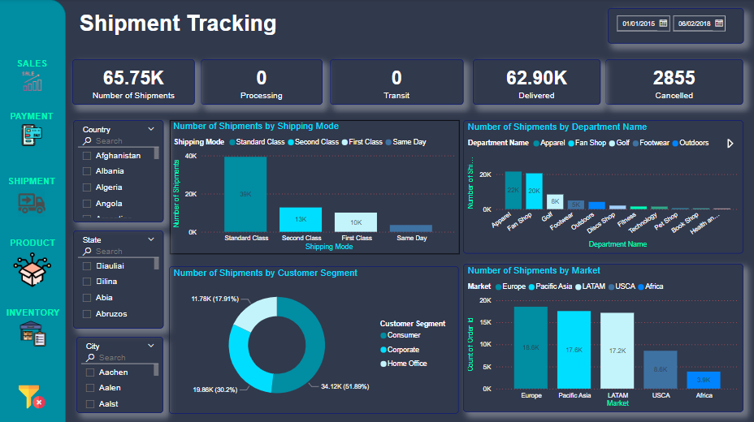

Slide 26
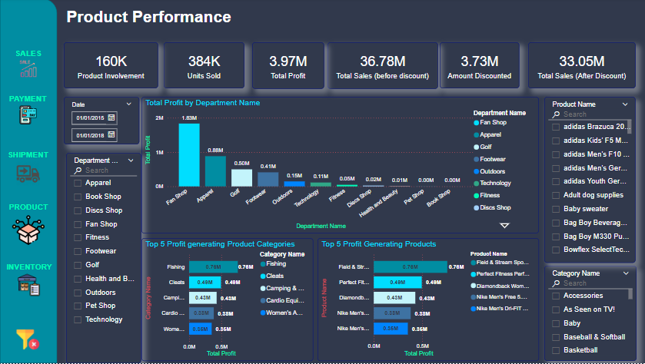

Slide 27
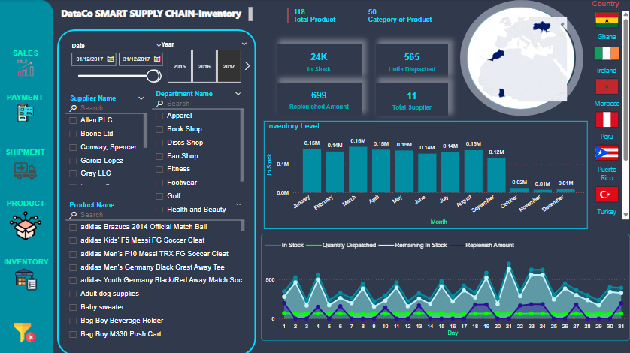

Slide 28
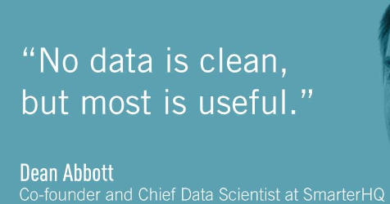
THANK YOU!

